Slide 1

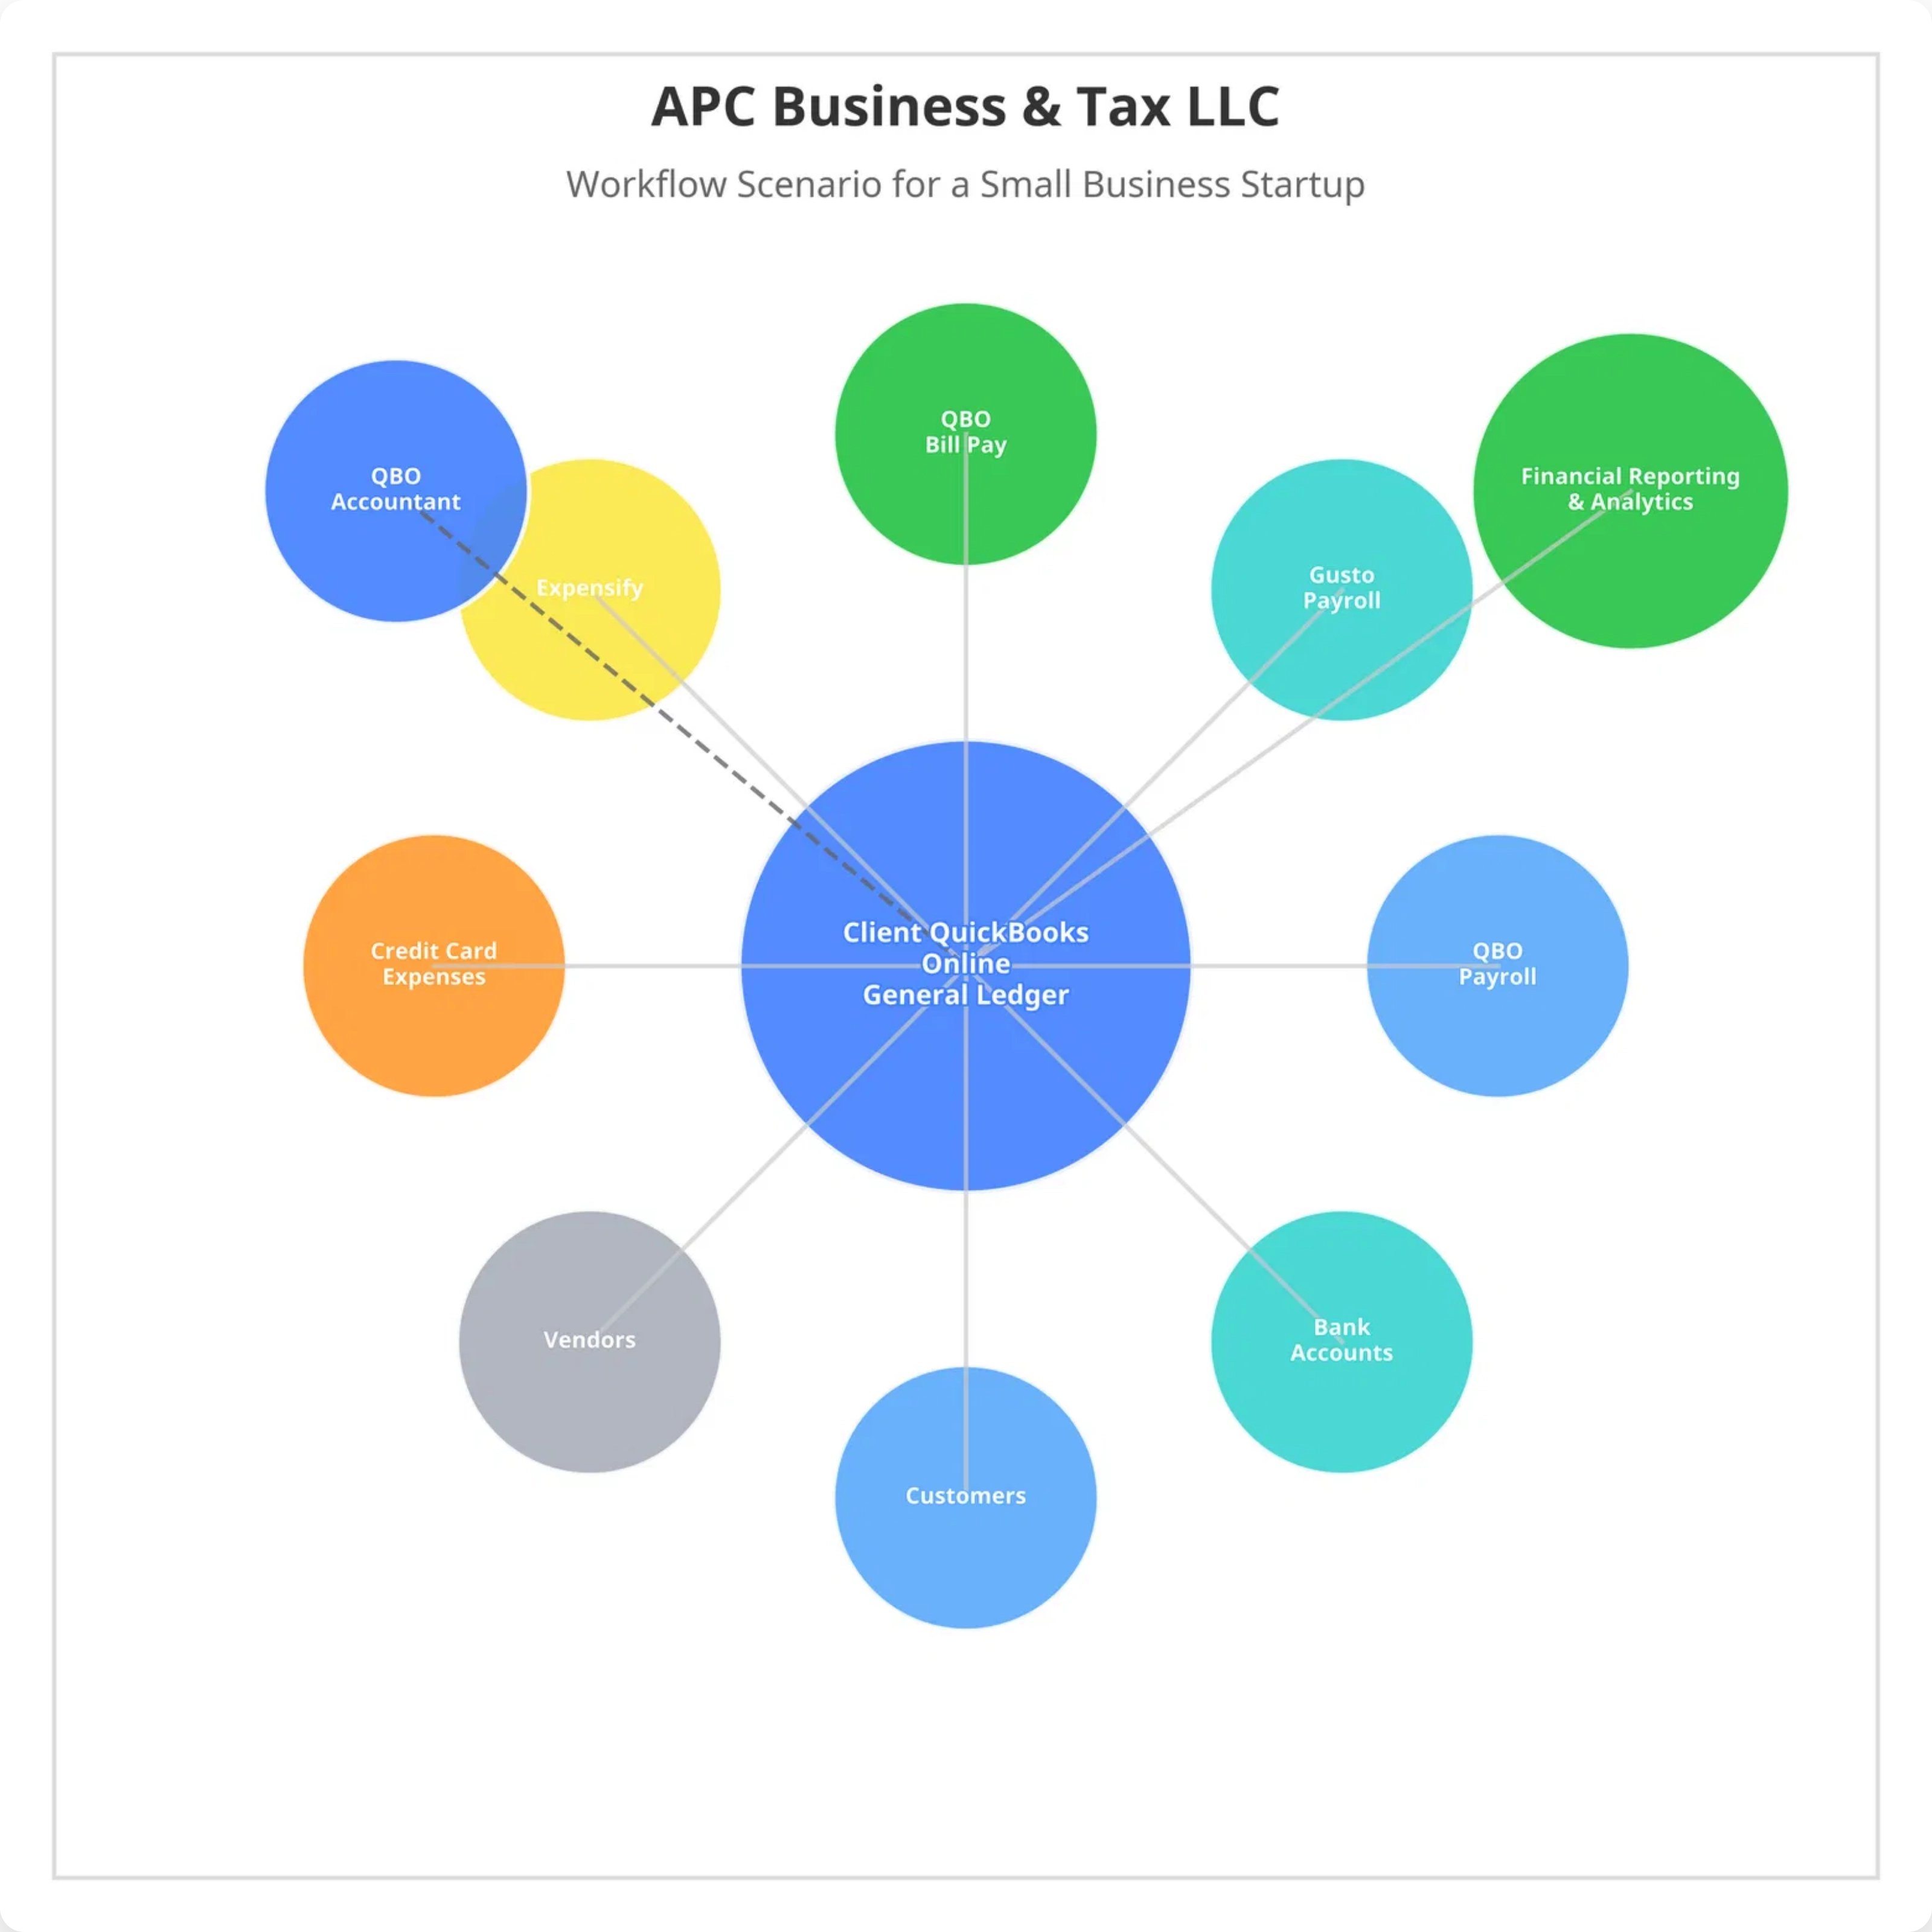

Slide 2

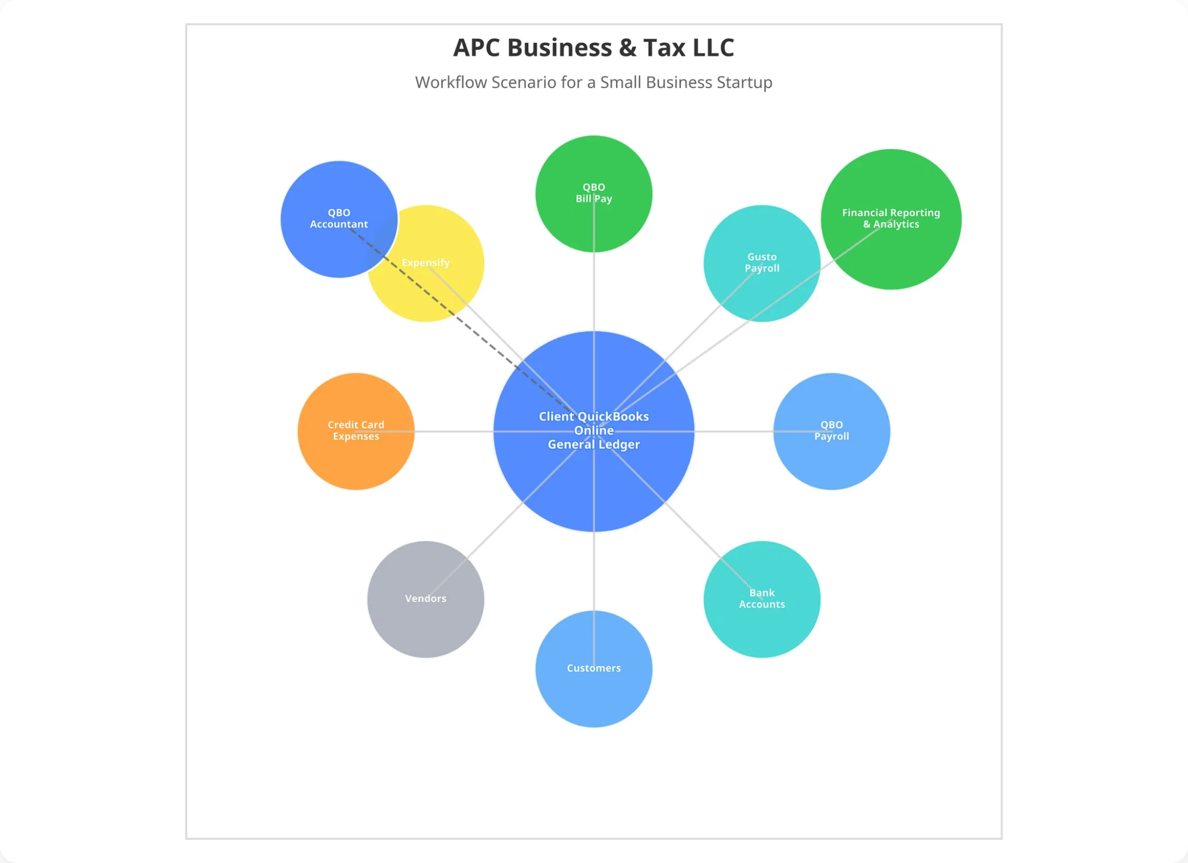
Workflow Overview
QuickBooks Online Centered Workflow
This workflow diagram illustrates how QuickBooks Online serves as the central hub for all financial operations in a small business startup, integrating various modules to create a seamless financial management ecosystem.
Central hub manages all financial transactions
10 connected modules for specialized functions
Solid lines represent direct data integration
Dotted line shows professional oversight connection
Process Payroll with QBO Payroll or Gusto
Credit card transactions with Expensify
We can process detail transaction or provide overview
Present financials to C-Suite or Board of Directors
Connection Types
Each connection line represents specific data flows between the QuickBooks Online General Ledger and connected modules, enabling automated synchronization and reducing manual entry.

Slide 3

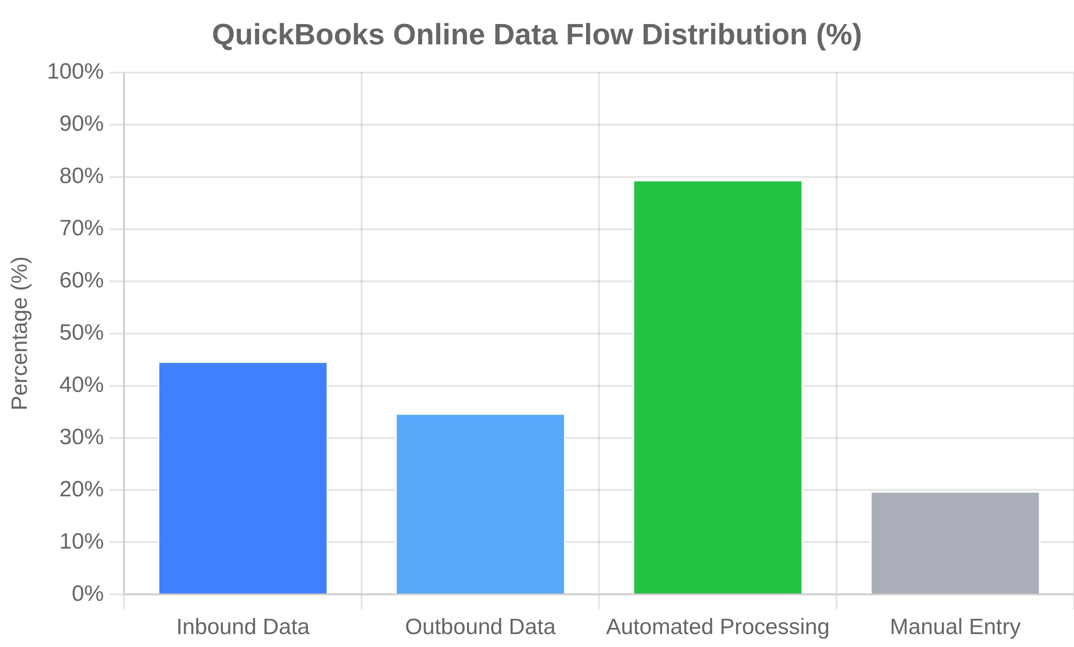
Central Hub: QuickBooks Online General Ledger
Core Functions
Information Flow Diagram
The QuickBooks Online General Ledger serves as the central repository for all financial data, providing a single source of truth for the business's financial position.
Key Capabilities
Comprehensive transaction recording and categorization
Chart of accounts management and customization
Multi-currency support for global operations
Audit trail tracking for compliance and security
Real-time financial position monitoring
Data Flow Management
Bidirectional data synchronization with all modules
Automated journal entry creation from connected systems
The central hub processes over 80% of financial data automatically through its connected modules, significantly reducing manual data entry and potential errors while providing real-time visibility into business performance.
Data validation and error checking protocols
Reconciliation tools for accuracy verification

Slide 4






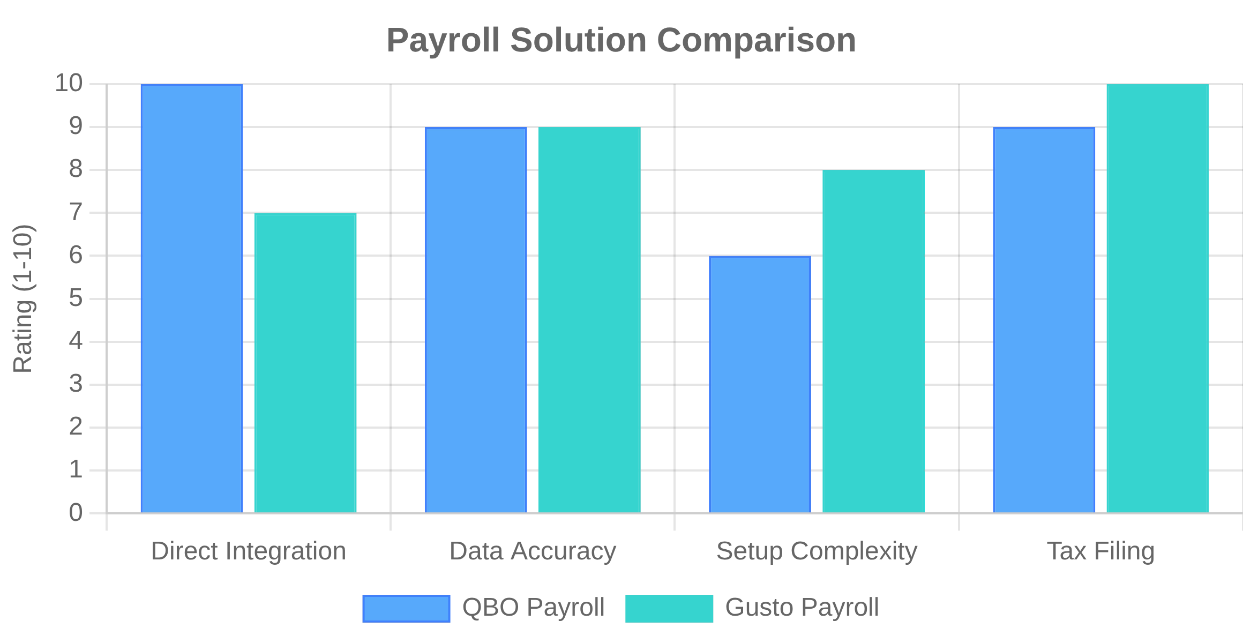
Payroll Connections
QBO Payroll → General Ledger
Gusto Payroll → General Ledger
Native QuickBooks Online payroll integration provides seamless data flow directly into the general ledger.
Third-party payroll service that integrates with QuickBooks Online through API connections.
Information Flow
Information Flow
Employee wages, payroll taxes, benefits deductions
Payroll summary data and tax calculations
Employer contributions and tax liabilities
Employee benefit costs and contractor payments
Actions
Actions
Automatic journal entries for payroll expenses
API-based data synchronization
Tax liability tracking and payment scheduling
Automated expense categorization

Slide 5


Financial Management Connections
QBO Bill Pay Connection
Bank Accounts & Credit Card Expenses
Information Flow
Bank Accounts Connection
To General Ledger:
Data Types:
Vendor payments, payment dates, check numbers, payment
methods
Bank statements, cleared checks, deposits, electronic transfers
From General Ledger:
Actions:
Approved bills, payment schedules, vendor information
Automatic bank feeds, transaction matching, reconciliation
Actions
Credit Card Expenses Connection
Automatic clearing of accounts payable
Data Types:
Bank account reconciliation
Purchase transactions, cash advances, fees, rewards/cashback
Payment scheduling and execution
Actions:
Automatic transaction import, expense categorization, receipt
matching

Slide 6



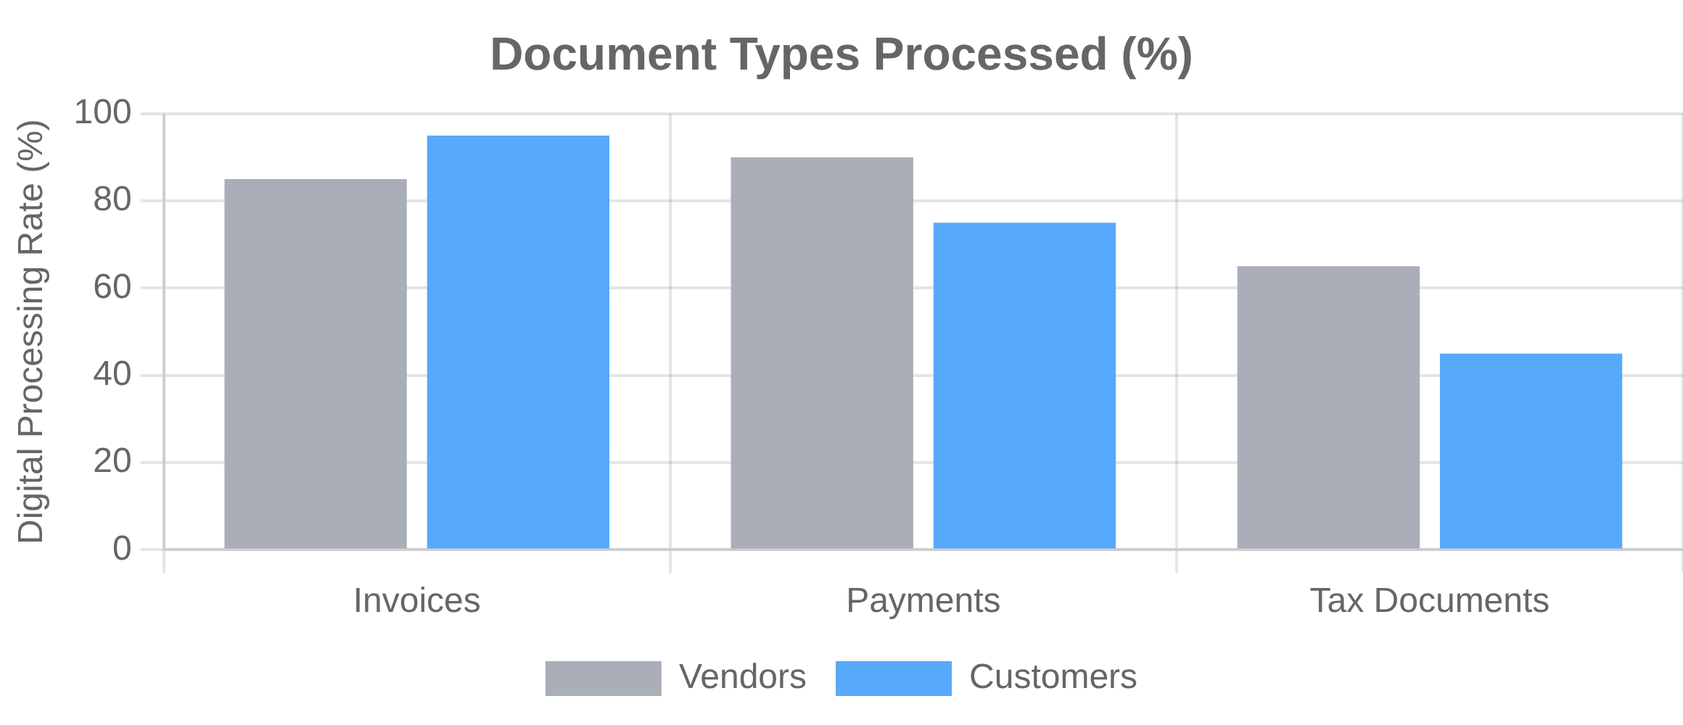
Business Relationship Connections
Vendors Connection
Customers Connection
The Vendors module connects to QuickBooks Online General Ledger to manage supplier relationships and accounts payable processes.
The Customers module integrates with QuickBooks Online General Ledger to manage client relationships and accounts receivable processes.
Information Flow
Information Flow
Invoice data and payment terms
Invoice generation and payment receipts
Vendor details and purchase orders
Customer data and sales tax calculations
Tax ID numbers and contract terms
Actions
Actions
Accounts receivable management
Accounts payable creation
Revenue recognition and collections tracking
Payment scheduling
1099 tracking and reporting

Slide 7

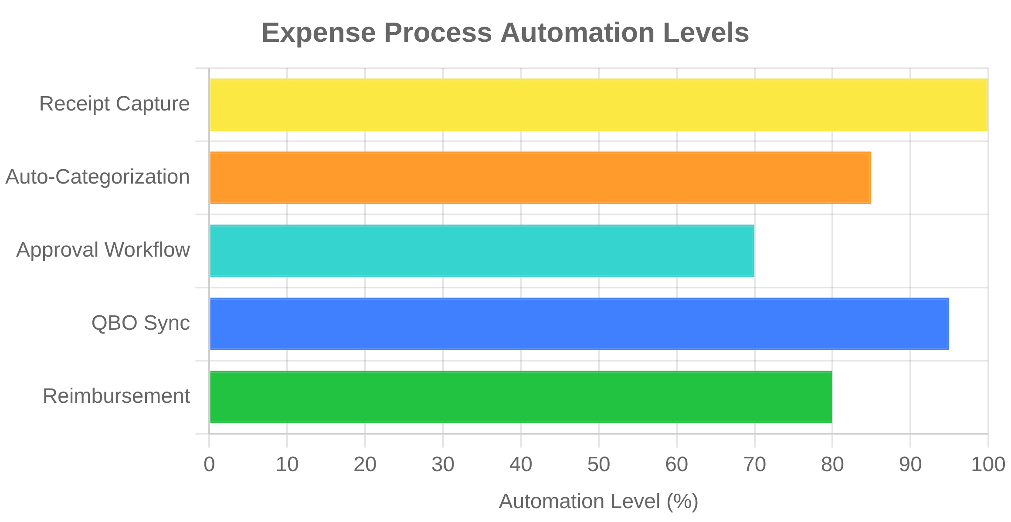
Expense Management Connection
Expensify → QuickBooks Online
The Expensify connection enables automated expense tracking, receipt management, and reimbursement processing. This integration streamlines expense reporting and ensures accurate financial records.
Information Flow:
Expense reports with categorized transactions
Digital receipt images and documentation
Mileage logs with GPS tracking data
Per diem calculations and allowances
Data Types
Credit card receipts with merchant details
Key Actions
Travel expenses with itinerary information
Automated expense categorization based on vendor
Meal allowances with attendee tracking
Reimbursement processing for employee expenses
Project codes for client billing allocation
Policy compliance verification for spending limits
Approval workflows and status updates
Project and client code assignment for billing
Reimbursement status and payment details
This bidirectional integration ensures that expense data flows seamlessly into the general ledger while maintaining proper audit trails and documentation for tax compliance.

Slide 8

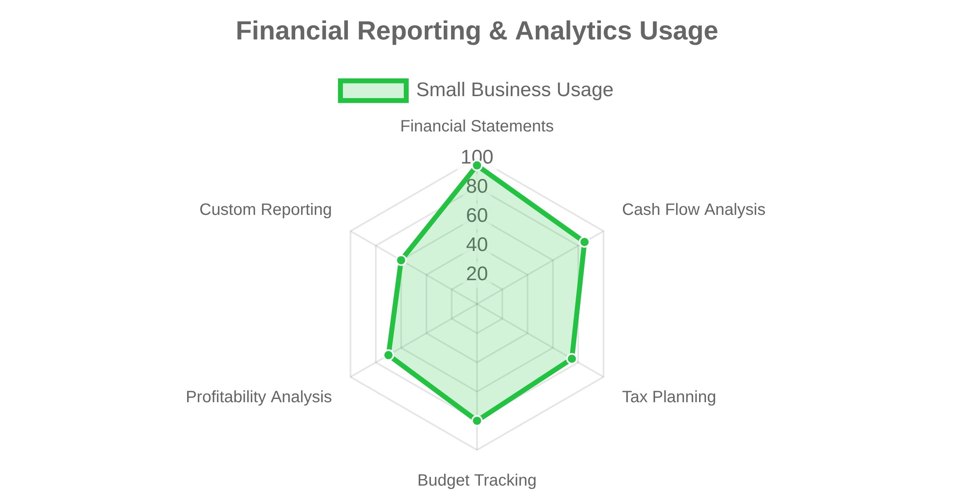








Financial Reporting & Analytics Connection
Information Flow
The Financial Reporting & Analytics module connects to QuickBooks Online General Ledger to provide comprehensive business intelligence and performance monitoring capabilities.
Data Types
Consolidated financial data from all connected modules
Key Performance Indicators (KPIs) for business metrics
Budget vs. actual comparisons with variance analysis
Trend analysis and forecasting projections
Report Types
Key Actions
Financial Statements:
P&L statements, balance sheets, cash flow
reports
Automated report generation on scheduled intervals
Operational Reports:
Sales analysis, inventory turnover, project
Real-time dashboard updates with current metrics
profitability
Variance analysis with highlighted exceptions
Compliance Reports:
Tax summaries, audit trails, regulatory filings
Custom report creation for specific business needs
Custom Analytics:
Industry benchmarks, custom KPIs, scenario
modeling
This connection enables data-driven decision making by transforming raw financial data into actionable business intelligence, accessible through customizable dashboards and scheduled reports.

Slide 9

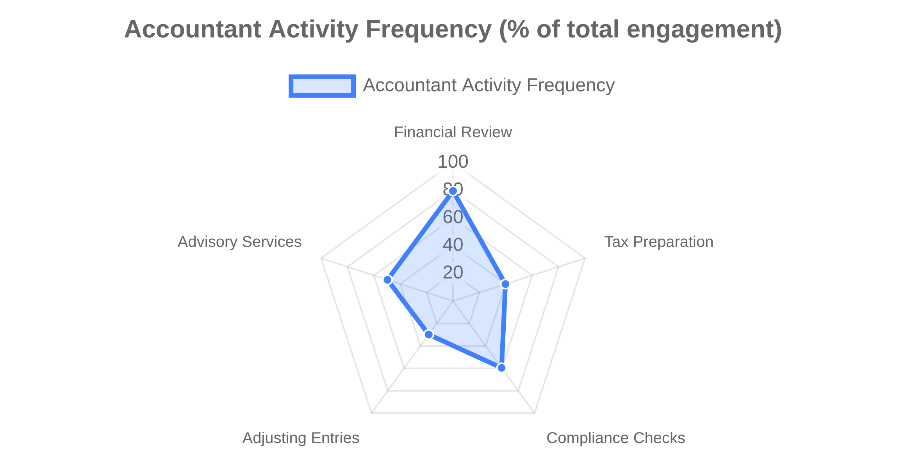

QBO Accountant Connection
Understanding the Dotted Line
Accountant Actions
The dotted line connection between QBO Accountant and the central QuickBooks Online General Ledger represents a professional oversight relationship rather than a direct system integration.
The QBO Accountant connection enables professional accounting services while maintaining appropriate separation between daily operations and professional oversight.
Information Flow
Review notes and adjusting entries
Tax preparation data and worksheets
Compliance reports and audit trails
Year-end closing recommendations
Why a Dotted Line?
Represents external professional relationship
Indicates periodic rather than continuous connection
Key Benefits
Shows advisory and oversight function
Denotes secure, controlled access to financial data
Professional oversight without disrupting daily operations
Secure, role-based access to financial data
Streamlined year-end closing and tax preparation
Expert guidance on financial reporting compliance
Ability to make adjusting entries with proper audit trail

Slide 10

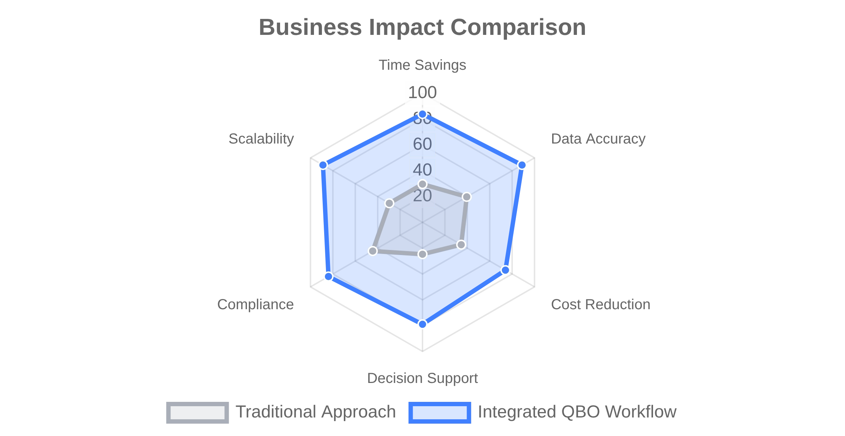






Benefits of Integrated Workflow
Key Business Advantages
Data Accuracy
Reduced manual data entry eliminates transcription errors and ensures consistent financial records.
Time Efficiency
Automated data flow saves significant time on bookkeeping tasks, allowing focus on strategic activities.
Real-time Visibility
Instant access to current financial position and performance metrics for better decision making.
Compliance
Additional Advantages
Automated tracking ensures better tax and regulatory compliance with proper documentation.
Scalability
System grows with business without major infrastructure changes or disruptions.
Cost Control
Better expense tracking and budget management capabilities reduce unnecessary spending.
This integrated workflow approach creates a cohesive financial ecosystem that supports business growth while maintaining accuracy, compliance, and efficiency.

